Slide 1
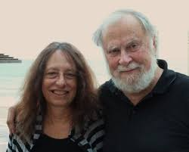

Carol Gilligan on 'In A Different Voice' https://www.youtube.com/watch?v=mG3_ZP6Drn0
“Carol Gilligan … has authored many books and papers including her landmark work, In A Different Voice: Psychological Theory and Women’s Development, which transformed psychological theory and feminist thinking.”

Slide 2
Contemporary Moral Problems
M-F12:00-1:00SAV 264
Instructor: Benjamin Hole
Email: bvhole@uw.edu
Office Hours: everyday after class

Slide 3

Agenda
Check-in on final papers
Clicker Quiz
Finish/discuss Hill
Begin MacKinnon

Slide 4
Check-in on final papers
Tell 1-2 people next to where you are at with your final papers
Have you outlined a good argumentative structure?
Are you comfortable explaining that structure to the class for critical examination?
Any questions about the outlines/presentations?
Which part of the outline do you expect to be the most difficult part to write-up for your final paper?
“The point of the paper is for you to demonstrate that you are familiar with a major view in ethical theory and are able to critically evaluate that view with philosophical rigor. Your critical evaluation is an opportunity for you to demonstrate your mastery of the philosophical skills you have practiced throughout the quarter. Therefore, the paper will be assessed on the basis of Interpretation and Analysis, Argumentation, Philosophical Knowledge and Methodology, and Communication.”

Slide 5
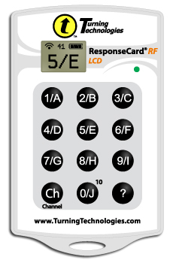
Please set your Turning Technology Clicker to channel 41
Press “Ch”, then “41”, then “Ch”
Clicker Quiz

Slide 6
According to Hill, the de-grading involved in degradation is most importantly a lowering of what kind of status?
physical
economic
moral
none of the above

Slide 7
According to Hill, which of the following is a legal implication of her view about victim pornography?
All pornography violates the First Amendment
Censoring pornography is a violation of the First Amendment
Victim pornography is an exchange of ideas
Victim pornography is a kind of “libel”
None of the above

Slide 8
MacKinnon argues that pornography is:
an inviolable expression of the right to free speech
a violation of Kant’s humanity formulation
a map that pretends to be a mirror
a violation of Mill’s harm principle
none of the above

Slide 9
“Pornography and Degradation”
Judith M. Hill

Slide 10
“Pornography and Degradation”
Victim Pornography
“the graphic depiction of situations in which women are degraded by sexual activity”
Hill
“A person is degraded when she is publicly, or at least overtly, treated as a means only, as something less than a person. Degradation involves de-grading at least in the sense that it entails a (false) imputation of a lower moral status than persons.”

Slide 11
“Pornography and Degradation”
Classic Problems for Kant
Rigorism
Vacuity (Sneaky Maxim Maker)
Covert Consequentialism
Moral Standing
Autonomy
Hill
“A person is degraded when she is publicly, or at least overtly, treated as a means only, as something less than a person. Degradation involves de-grading at least in the sense that it entails a (false) imputation of a lower moral status than persons.”

Slide 12
“Pornography and Degradation”
A moral implication:
Given that it is wrong to treat persons merely as means, and given that victim pornography depicts women as mere means (as “less than persons”), it follows that victim pornography is morally objectionable.
A legal implication:
Because victim pornography depicts women as less than persons, the pornography industry is guilty of libel
a false statement that is damaging to a person's reputation.

Slide 13
Hill’s Moral Implication
Strongly Agree
Agree
Somewhat Agree
Neutral
Somewhat Disagree
Disagree
Strongly Disagree

Slide 14
Hill’s Legal Implication
Strongly Agree
Agree
Somewhat Agree
Neutral
Somewhat Disagree
Disagree
Strongly Disagree

Slide 15
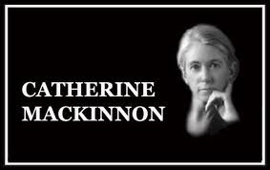
“Pornography, Civil Rights, and Speech”
http://on.aol.com/video/catharine-mackinnon--the-pornography-phenomenon-517647554

Slide 16
Legal theorist and activist
Responsible for the modern concept of sexual harassment
Responsible for revision of anti-pornography law in several jurisdictions

Slide 17
The principle of charity
“in various versions, it constrains the interpreter to maximize the truth or rationality in the subject's sayings.“ (Simon Blackburn, Diction of Philosophy, oup, 1994, 32)

Slide 18
For Mackinnon, what is wrong about pornography is subordination, i.e., that it promotes immoral power dynamics by perpetuating the degradation or marginalization of women.
Social identity is not something that is innate, but constructed, and pornography perpetuates oppressive hetereo-normative gender roles.

Slide 19
Pornography is wrong because it subordinates
Strongly Agree
Agree
Somewhat Agree
Neutral
Somewhat Disagree
Disagree
Strongly Disagree

